Slide 1
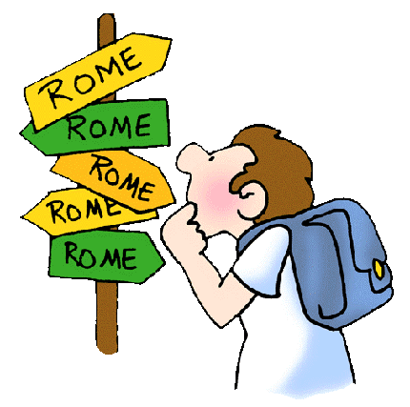
Ancient Rome
I can explain how the myth of Romulus and Remus affected the settlement of early Rome.
I can explain how the geography of Rome affected its people
I can describe the ancestors of the Romans

Slide 2

Rome’s Geographic Setting
I can explain how the geography of Rome affected its people
Rome was a peninsula
Unlike Greece, Rome had fertile soil for farming
The Tiber River provided fresh water and easy travel
Rome was built around 7 hills, which made them easy to defend

Slide 3
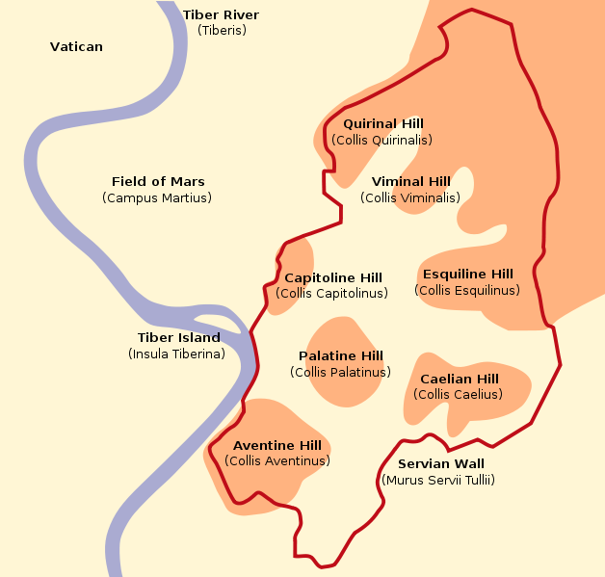
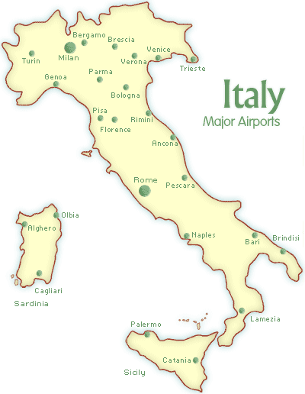

Slide 4
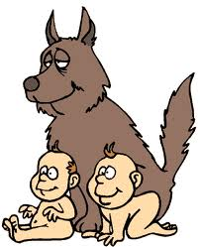
Mythical Origins of Rome
I can explain how the myth of Romulus and Remus affected the settlement of early Rome.
The ancient Romans loved to hear the story of Romulus and Remus. In their eyes, this story explained why Rome had the right to rule.
According to legend, Romulus and Remus were the original founders of the city of Rome

Slide 5
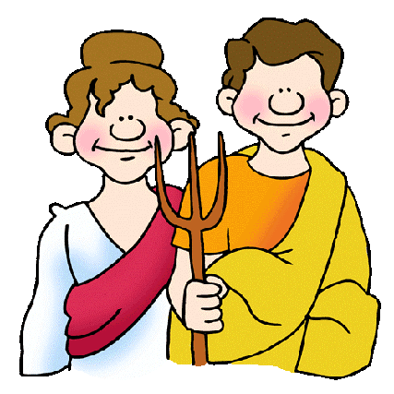
Rome’s Beginnings
I can describe the ancestors of the Romans
Little is known about where the Romans actually came from
About 600 B.C. a group called the Etruscans ruled over Rome. Etruscan king Tarquin the Proud ruled very harshly.
About 509 B.C. the Romans revolted against the Etruscan kings and drove them out.
Many Etruscan ideas lived on in Rome (Roman Gods, togas, and Greek Alphabet)

Slide 6

Rome Becomes a Republic
After driving out the Etruscan kings, Rome vowed to never again put so much trust into kings
Rome created a republic (representative democracy) where citizens voted on leaders who made the laws

Slide 7
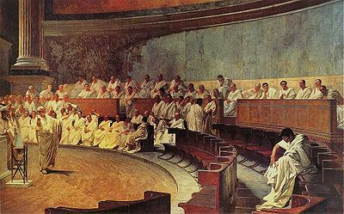
Rome Becomes a Republic Cont’d
The Republic was made up of 3 parts:
Consuls- 2 leaders chosen from the senate, served 1 year terms. (They were the leaders of the government)
Consuls had the power to veto (which means “I forbid it”)
2. Senate- made up of 300 patricians (upper class citizens)
3. Assembly – made up of plebeians (lower class citizens)
In an emergency when decisions had to be made quickly, a dictator would appointed, but could only hold power for 6 months

Slide 8
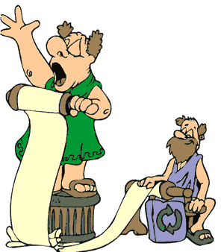
Patricians vs. Plebeians
Patricians fought to be the leaders of the government and the plebeians thought that the patricians did not respect them
Many Patricians grew wealthy from Rome’s conquests, while many plebeians lost their jobs
Eventually, Plebeians refused to fight in the army
The Patricians were forced to create the Twelve Tables- a code of laws that applied equally to all citizens

Slide 9
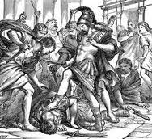
The End of the Republic
Even though Rome had conquered a large area by 120 BC, the Plebeians and Patricians continued to fight each other
Consuls no longer respected each others’ veto votes
Rome dissolved into a civil war with private armies fighting each other
In 49 B.C the military leader Julius Caesar led his troops into Rome and became the dictator of Rome in 48 B.C

Slide 10
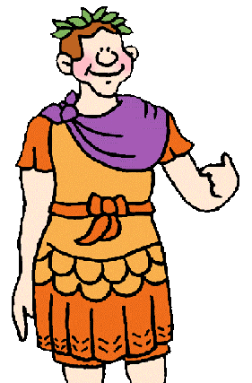
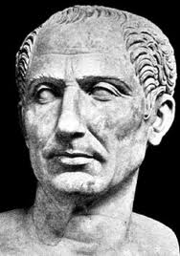

Julius Caesar
As dictator, Julius Caesar took many useful steps in reorganizing the government
He kept the senators on as his advisors
However, many senators felt as though Rome was once again under the rule of a king
On March 15, 44 B.C. Julius Caesar was assassinated by the senators
A civil war broke out to determine the next ruler. In 27 B.C. Octavian (Caesar’s adopted son) became the first emperor of Rome.
Octavian took the title of Augustus meaning “highly respected”

Slide 11
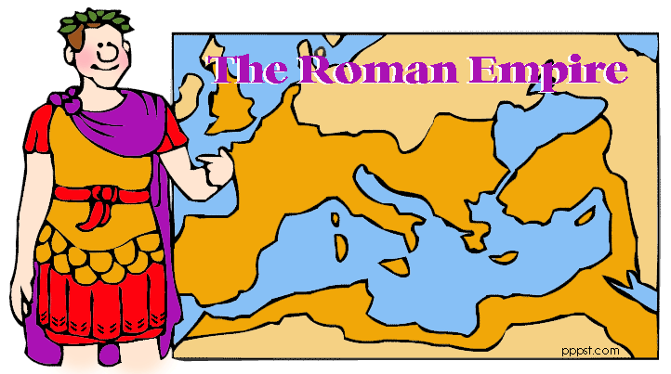
By the time Augustus took power Rome controlled much of the Mediterranean Sea
Augustus returned peace and prosperity to Rome, and shared his power with the senate
Instead of turning conquered peoples into slaves, Augustus allowed them to govern themselves as provinces
Each province had a Roman governor and was supported by an army

Slide 12
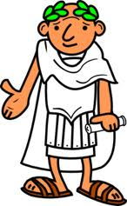
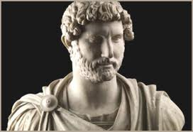
The Good and the Terrible
After Augustus death in 14 A.D, Rome went through a series of emperors: some good, some bad.
Caligula and Nero were considered to be two of the worst
The greatest was the emperor Hadrian, who worked hard to build a good government and to create laws that protected women, children and slaves.

Slide 13
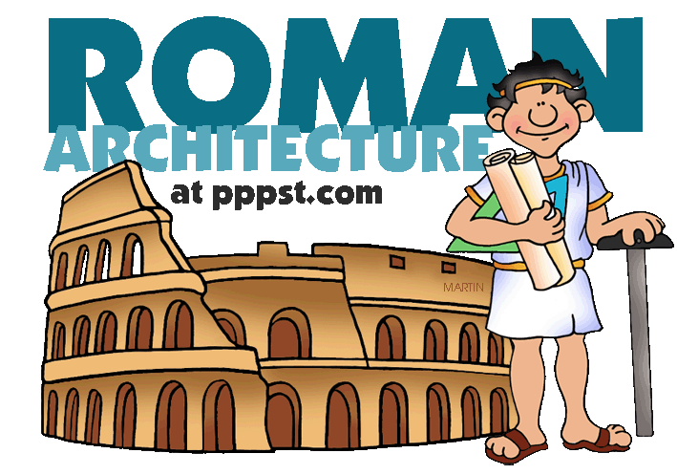
Greek Influence
The Romans greatly admired Greek achievements in art, architecture and government
However, while the Greeks were interested in new ideas, the Romans were more interested in building things.
Under the Romans, architecture and engineering prospered

Slide 14
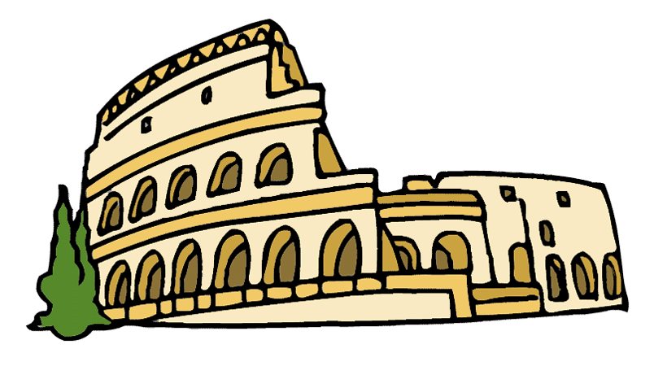
Architecture and Engineering
The Romans developed a new building material- concrete
The greatest Roman building was the coliseum- an arena that held over 50,000 spectators

Slide 15
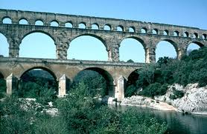
Architecture and Engineering Cont’d
Romans created roads from the city of Rome to every part of the empire. The saying “All Roads Lead to Rome” was actually true!
Romans also created aqueducts- structures that carried water over long distances

Slide 16
Daily Life Among the Romans
Pages 203-207

Slide 17
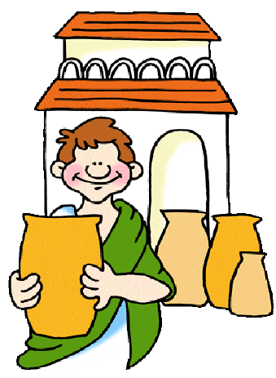
Daily Life Amongst the Romans:
The Rich, the Poor, and the Slaves
Tourists and merchants flocked to the city of Rome.
Its marketplaces and shops had more goods than any other city.
Roman society had very few rich people. The majority of the citizens were poor.

Slide 18
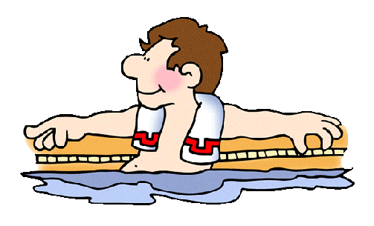
A Life of Luxury
The rich often had homes in the city and country.
They were known for their feasts.
Foods: wild boar, flamingo, ostrich, dormouse cooked in honey, bread
At the feasts there were musicians, performers, poets etc.
Went to Roman baths for relaxing, talking politics etc. There were as many as 900 baths in Rome.

Slide 19
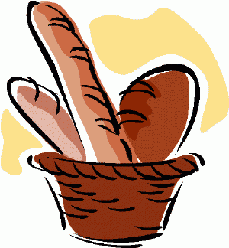
Another Way of Life for the Poor
Lived in small apartments with no running water, toilets or kitchens
Garbage and human waste tossed out the window
Many fires in apartments because the apartments were made of wood
The poor would receive wheat in order to survive.

Slide 20
The Colosseum
The Colosseum was designed to provide entertainment for the poor
This would prevent people from rioting or rebelling against the leaders
The Collosseum events included: animals fighting animals or humans, humans fighting humans, mock navy battles, public executions
http://www.bbc.co.uk/history/ancient/romans/launch_ani_colosseum.shtml

Slide 21
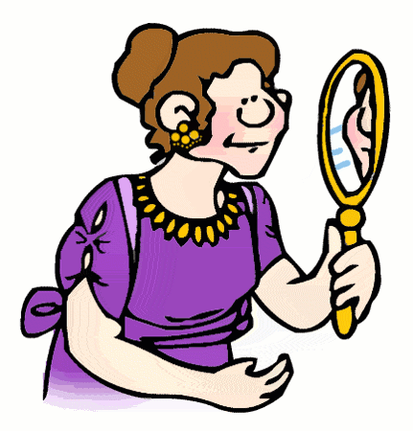
Family Life
Roman families were rewarded by the government for having many children
Husband had absolute power over the family
The wealthier a woman’s husband was, the more freedom she had.

Slide 22
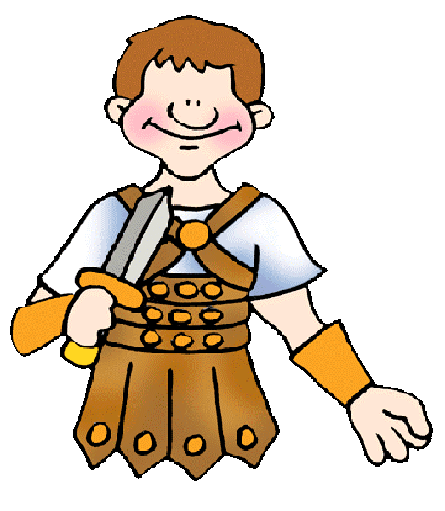
Slavery in Rome
Almost all wealthy families have several slaves
Even poor people might have a slave
Household slaves were often treated better compared to slaves working on roads, mines etc.
Some slaves were even able to buy their freedom. (saved wages or tips)
http://rome.mrdonn.org/spartacus.html

Slide 23
Christianity in Rome
A new Religion called Christianity emerged
Christianity was the religion based on the teachings of Jesus Christ
One of the many religions in the Empire
Romans were tolerant of other religions, but the people had to show loyalty to the emperor and mythology
During the beginning of the Roman Empire, the followers of Jesus were persecuted.
As the religion grew, emperors felt intimidated by Christianity.
Over time, Christianity continued to spread through the empire.

Slide 24
The Decline of the Roman Empire
Weak Corrupt Rulers-
  Stole money from the treasury to use for themselves (economy fell apart)
  Senate lost power
  Between 180 AD and 284 AD Rome had 29 emperors, most were murdered

Slide 25
The Decline of the Roman Empire cont’d
A Mercenary Army
  Instead of having loyal citizens fight for Rome, the army was made up on mercenaries
  Mercenaries were foreign soldiers paid to fight
Economic Problems
  Rome stopped expanding, so no new land or wealth was collected
  Most of the money was used to pay the mercenaries
  More coins were created which caused inflation

Slide 26
The Decline of the Roman Empire cont’d
Size of the Empire
  Rome had grown too big to be controlled from one place
  Enemies of Rome began to attack it from all over

Slide 27
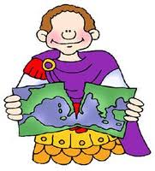
2 Emperors tried to save Rome
Diocletian
  Persecuted Christians
  Tried to strengthen Rome’s army
  Improved system for collecting taxes
  Divided the empire into 2 parts (Eastern and Western Rome) and appointed a co-emperor to rule over the other part

Slide 28
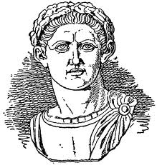
2 Emperors tried to save Rome
Constantine
  Converted to Christianity and allowed Christians to practice freely
  This strengthened the Christian Church
  Moved the capital of the Roman Empire from the city of Rome to the city of Byzantium
  Byzantium was later renamed Constantinople in his honor

Slide 29
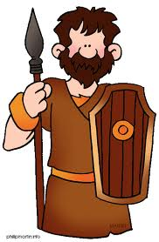
The Fall of Rome
After Constantine’s death invaders started to invade Roman territory
Germanic tribes (who the Romans called barbarians) attacked the Western portion of the Roman Empire
476 AD marks the official fall of Rome, because the Germanic tribes officially took control of Rome
However, the Eastern portion survived and became known as the Byzantine Empire

Slide 30
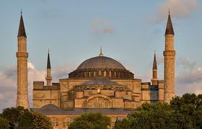
The Byzantine Empire
Eastern portion of the former Roman Empire became the Byzantine Empire
Justinian I- powerful Byzantine ruler; reigned from 527 to 565
  He expanded the empire
  Created the Justinian Code (a legal system that guided Byzantine Society)
  Built impressive structures such as the
  Hagia Sophia Church

Slide 31
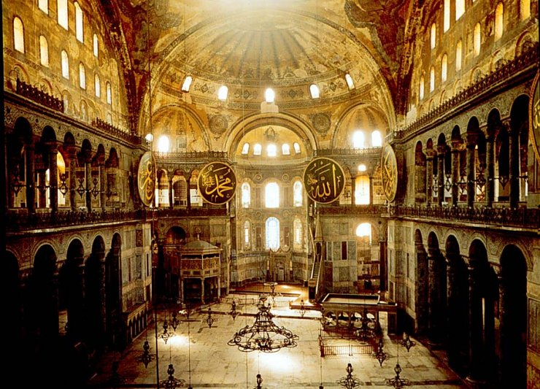

Slide 32
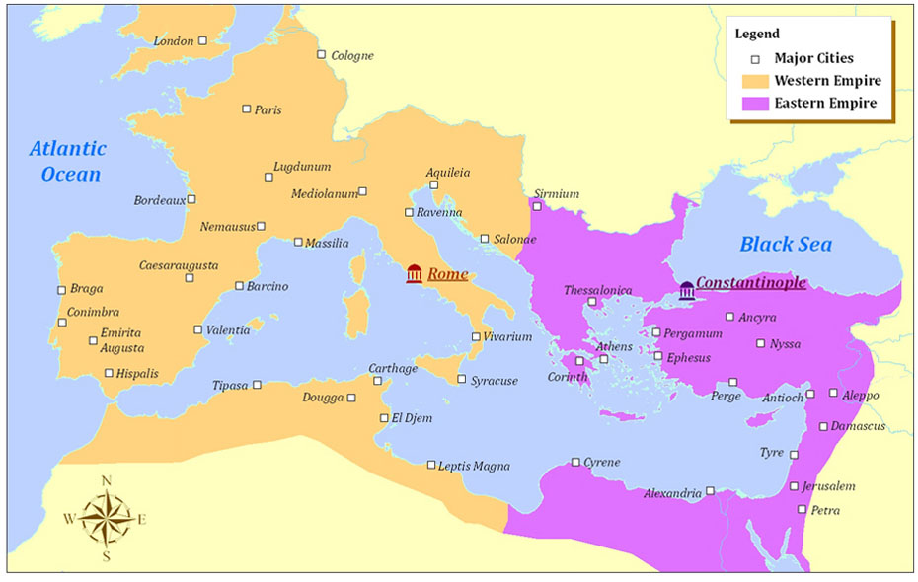
Constantinople
Capital of the Byzantine Empire
It’s location made it the center of trade between Africa, Asia and Europe

Slide 33
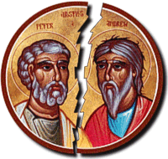
Christianity Splits
Byzantine Emperors and the Popes fought for control over the Christian Church
Emperor Leo III banned the use of icons by Eastern Christians in 730
Pope supported icons; so he excommunicated Leo III from the Church
In 1054 a schism (split in the church) occurred
  West- Roman Catholic- led by the pope
  East- Eastern Orthodox Church- led by the patriarch

